Slide 1

Navigation Application with AI (Pattern and Image Recognition)
Group 1:
- Indira Priyadarshini (is13658n@pace.edu)
- Kartik Kannan (kk96691n@pace.edu)
- Sunil (sm12210n@pace.edu)
- Pranav (pk73658n@pace.edu)
- Bharath (sv90693n@pace.edu)
- Rahul (rs15193n@pace.edu)
Sprint 2 Deliverable :
CS 691 - Computer Science Project 1
Spring 2020

Slide 2
Introduction
Initially instant location recognition with an app - Location or scan interface with visual recognition and voice over.
Identifying the locations and recommendations.
Combining image classifications and deep learning on how the process works.
Gathering images.
Create a database that has - Information about the location selected like place, timing, season, travel fare (coupon, entry tickets, offers), location (by all means possible), search engine (advanced options like near to pier, downtown), other recommendations,reviews and feedback.
On selecting the location.
User interface has been created for login, signup and contact page.

Slide 3

Amazon Rekognition:
Amazon Rekognition makes it easy to add image and video analysis to your applications using proven, highly scalable, deep learning technology that requires no machine learning expertise to use.
With Amazon Rekognition, you can identify objects, people, text, scenes, and activities in images and videos, as well as detect any inappropriate content.
Amazon Rekognition also provides highly accurate facial analysis and facial search capabilities that you can use to detect, analyze, and compare faces for a wide variety of user verification, people counting, and public safety use cases.
With Amazon Rekognition Custom Labels, you can identify the objects and scenes in images that are specific to your business needs. For example, you can build a model to classify specific machine parts on your assembly line or to detect unhealthy plants.
Amazon Rekognition Custom Labels takes care of the heavy lifting of model development for you, so no machine learning experience is required. You simply need to supply images of objects or scenes you want to identify, and the service handles the rest.

Slide 4
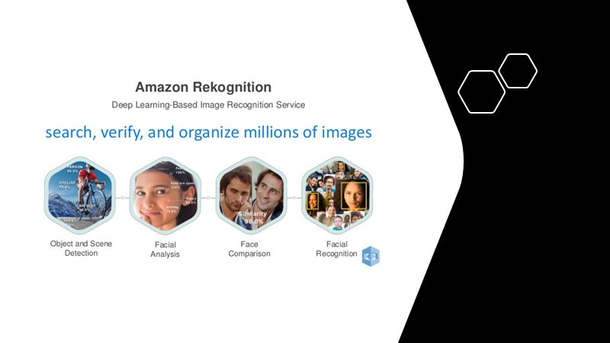

Slide 5
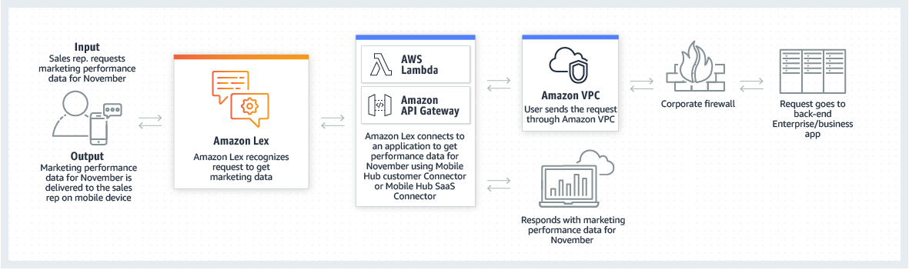
Amazon Lex:
Amazon Lex is a web service that allows users to include conversational interactions of voice and text in the software applications.
It is a web service, which uses the technology that powers Amazon's virtual assistant Alexa. Lex uses automatic speech recognition to convert speech to text, natural language processing to understand spoken instruction and user intent. Similar to many AI devices work like Alexa, OK Google, Hey Siri,
In our web app also an user will speak a word or a sentence and accordingly it will will give results. For example, if a user says Yankee Stadium on our web app, it will provide user with all the essential information and relevant pictures of the Yankee Stadium.

Slide 6
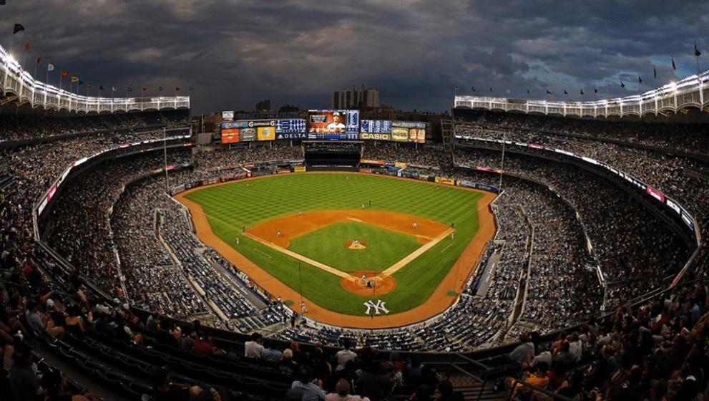
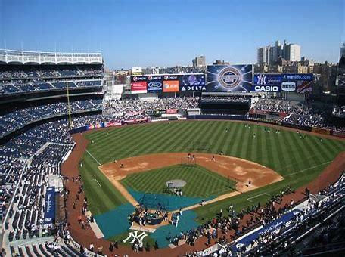
User Story
If a person from Los Angeles visits New York to attend a game of soccer between New York City vs LA galaxy at Yankee Stadium, instead of him searching and asking people about the directions and important information about the stadium, he easily says Yankee stadium into our web app and it will easily provide user with all required information about the same.

Slide 7
Natural Language Processing
Natural Language Processing, usually shortened as NLP, is a branch of artificial intelligence that deals with the interaction between computers and humans using the natural language. The ultimate objective of NLP is to read, decipher, understand, and make sense of the human languages in a manner that is valuable.Natural language processing (NLP) is a subfield of computer science and artificial intelligence concerned with the interactions between computers and human languages, in particular how to program computers to process and analyze large amounts of natural language data. The tasks in using NLP are:
Content categorization: A linguistic-based document summary, including search and indexing, content alerts and duplication detection.
Topic discovery and modeling: Accurately capture the meaning and themes in text collections, and apply
Contextual extraction: Automatically pull structured information from text-based sources.
Sentiment analysis: Identifying the mood or subjective opinions within large amounts of text, including average sentiment and opinion mining.
Speech-to-text and text-to-speech conversion: Transforming voice commands into written text, and vice versa.
Document summarization: Automatically generating synopses of large bodies of text.
Machine translation: Automatic translation of text or speech from one language to another.

Slide 8
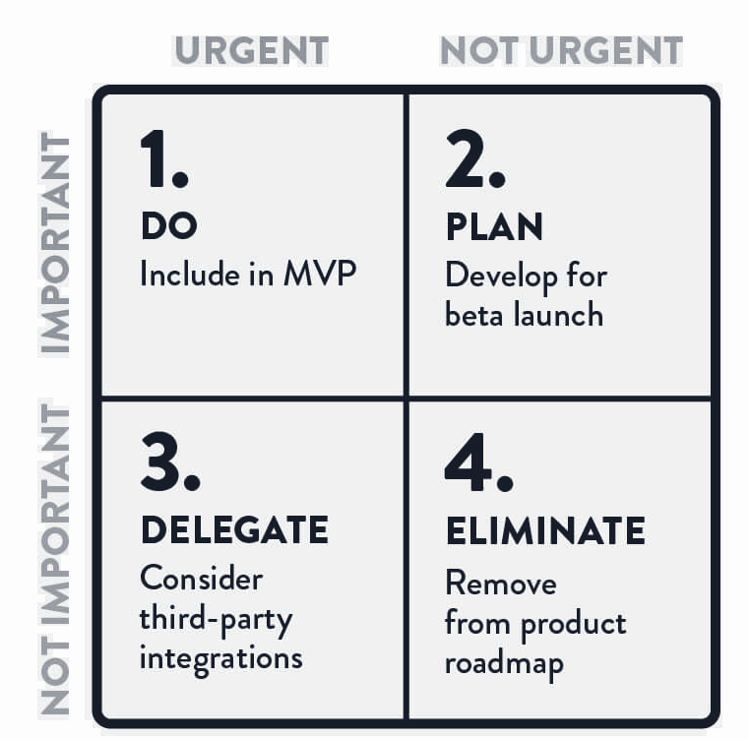
MVP (Minimum Viable Product)
DO -Scan the picture and navigate with useful information
PLAN - Clone the Google API with required information in mobile application
DELEGATE- Consider third-party permitted applications
ELIMINATE - Remove multiple web pages and make it user friendly.

Slide 9
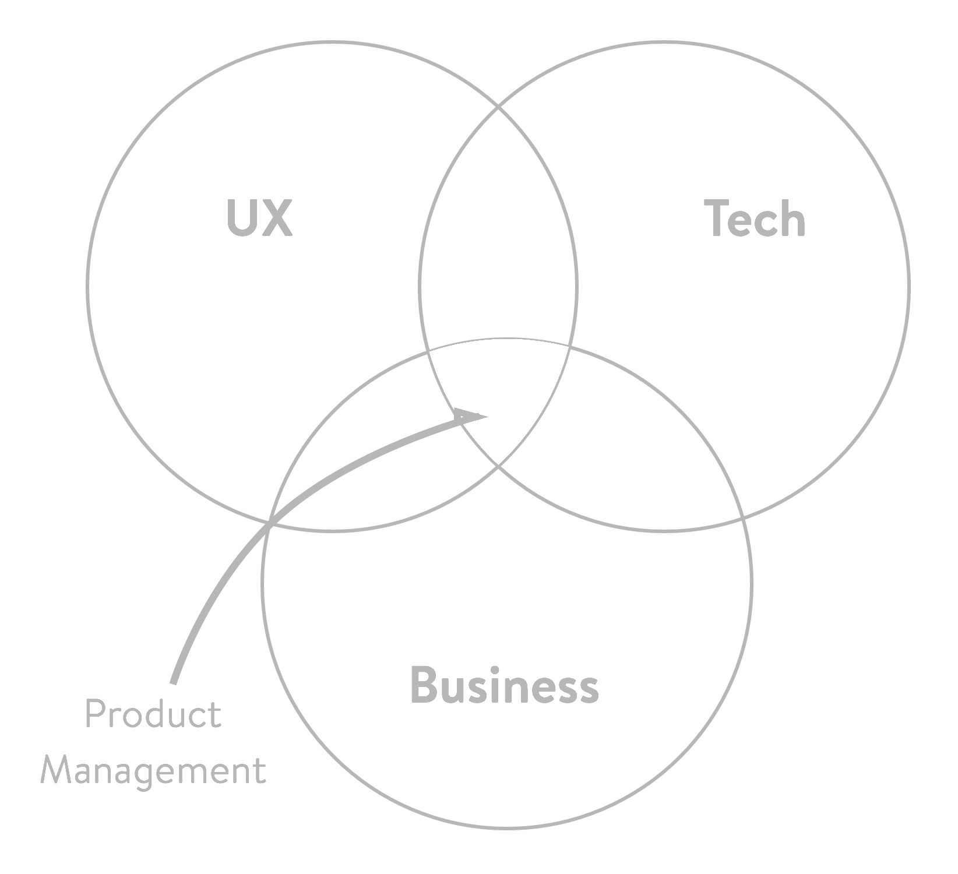
MVP (Minimum Viable Product)

Slide 10
Product Backlog
SPRINT 2 | Module | Priority | Issues Encountered | Status
Task 1 | Image Collection with name tag | High | None | Completed
Task 2 | Sign up and login page | High | Coding | In Progress

Slide 11
Test Cases
Cases | Acceptance Criteria
As a User who has an account for the website: As a logged-out user, the user wants to be able to sign in to a website. So that I can find access it through his profile. System user signs in with valid credentials. When the user fills in the “Username” and “Password” fields with my authentication credentials and clicks the Sign-In button Then the system signs the user in. | To ensure the application user is able to: - Navigate through the login page -To login and logout on demand
As a website user: As a website user, if the user wants to submit feedback regarding the website or the application. So that the website owners can consider the opinion or concern of the users who use the application, during future website updates and bug fixes. | To ensure the application user is able to: -Navigate through the website to find the feedback option -Write out feedback and to send it to the website owner.
As a website user: As a website user, the user wants to have an option of creating an account to use the application with a better user experience. So, the website provides a sign up option on the login page through which the user can create an account, with a unique username and a password. The user uses his login credentials which were created at the sign up page, to login and use the application. | To ensure the application user is able to: -To be able to create an account using sign up page -To be able to use login credentials created with the sign up page

Slide 12
Acceptance Criteria: Description
Acceptance criteria (AC) are the conditions that a software product must meet to be accepted by a user, a customer, or other system.
Feature scope detalization: It defines the boundaries of user stories. They provide precise details on functionality that help the team understand whether the story is completed and works as expected.
Setting communication: Acceptance criteria synchronize the visions of the client and the development team.
Feature estimation: Acceptance criteria specify what exactly must be developed by the team. Once the team has precise requirements, they can split user stories into tasks that can be correctly estimated.
Streamlining acceptance testing: AC are the basis of the user story acceptance testing. Each acceptance criterion must be independently testable and thus have a clear pass or fail scenarios.

Slide 13
Test Cases
Sl. no | Description | Status | Priority
1 | Make content Searchable | In progress | High
2 | Flag Inappropriate Content | In progress | High
3 | Enable Digital Identity | In progress | High
4 | Quick responses to safety | In progress | High
5 | Identify Products and Landmarks | In progress | High
6 | Analyze patterns | In progress | High

Slide 14
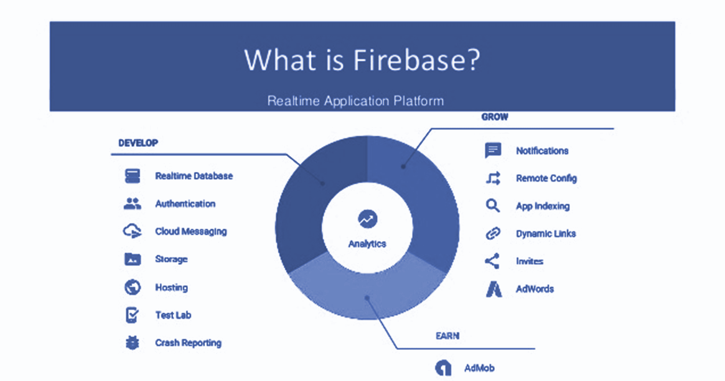

Slide 15
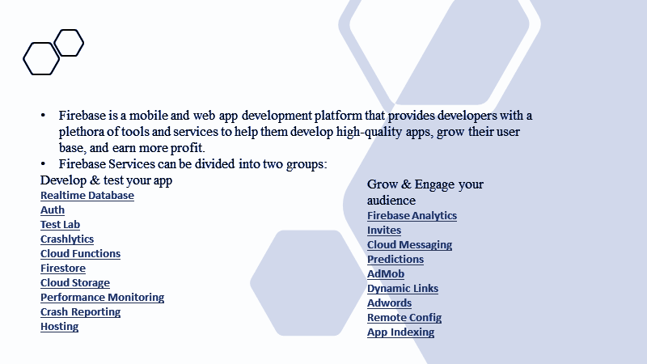

Slide 16
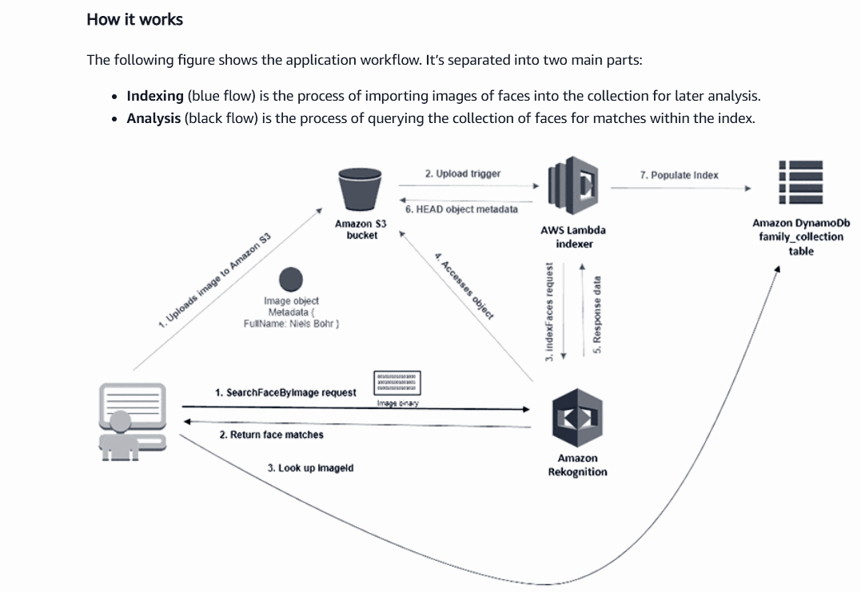
Technologies Used
Face Recognition Service Using Amazon Rekognition:

Slide 17
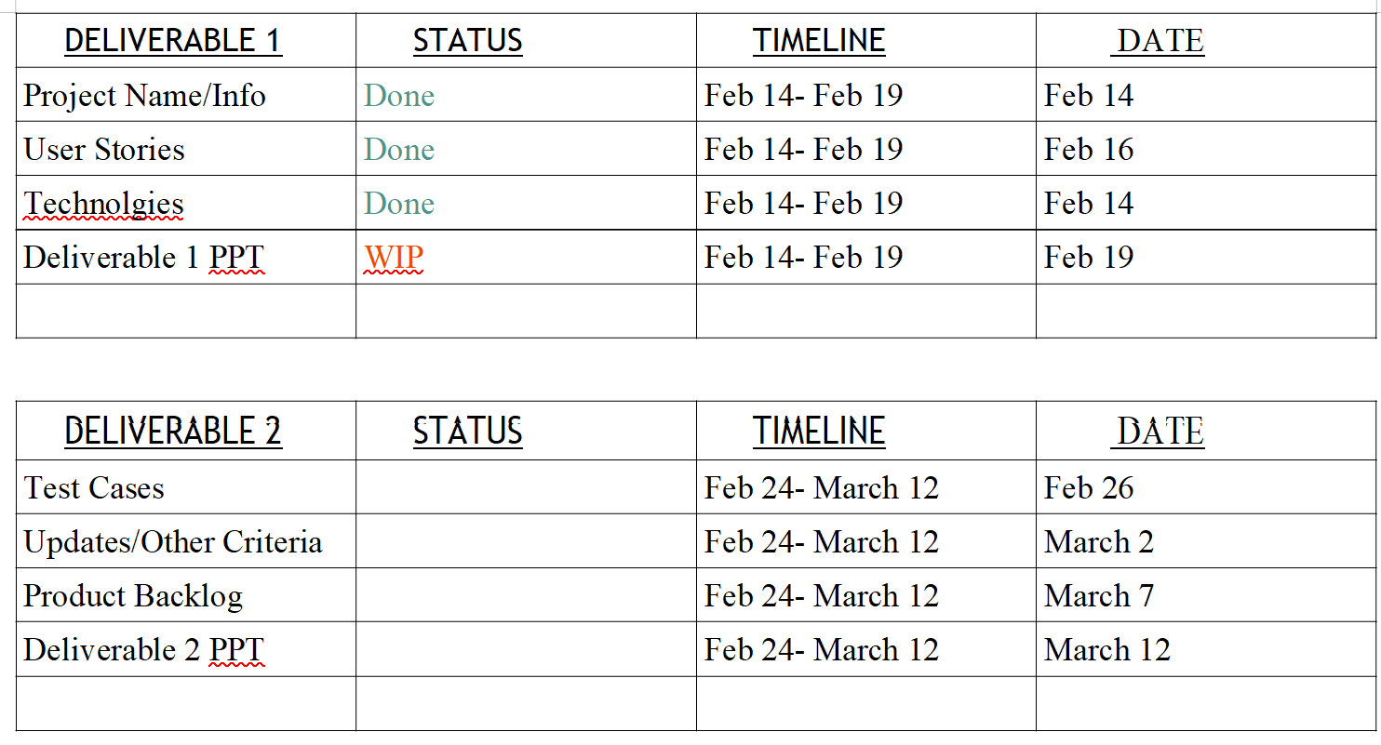
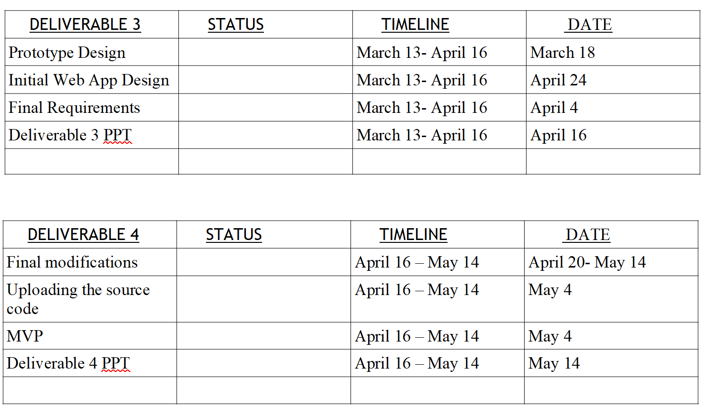
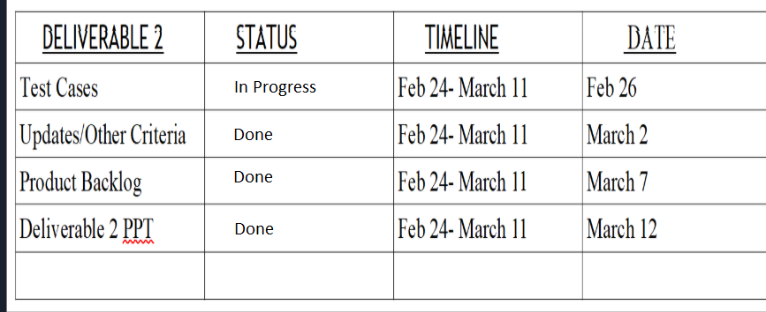
Schedule

Slide 18
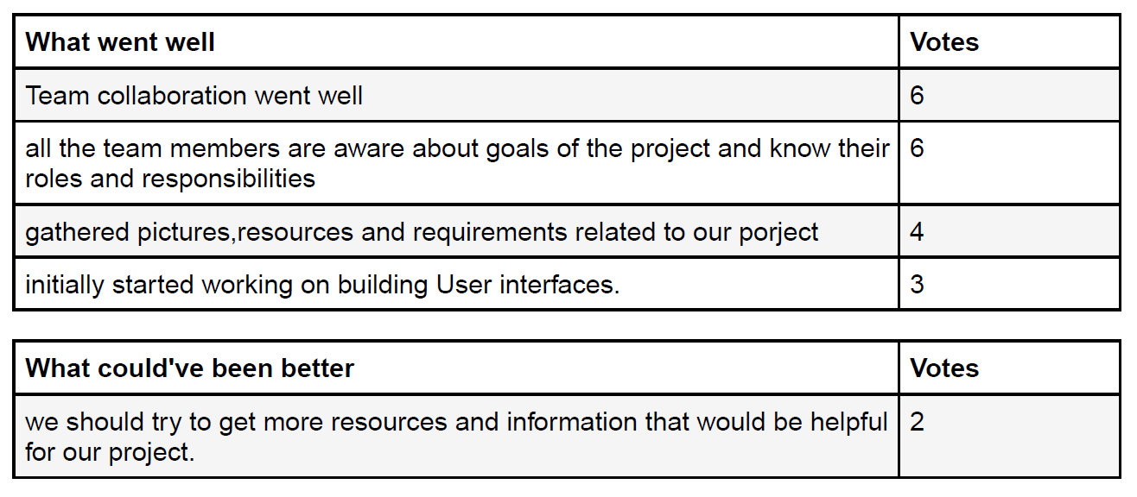
Retrospective

Slide 19
References
https://www.sas.com/en_us/insights/analytics/what-is-natural-language-processing-nlp.html
https://www.skillsyouneed.com/ps/nlp.html
https://en.wikipedia.org/wiki/Amazon_Lex
https://aws.amazon.com/rekognition/
https://aws.amazon.com/rekognition/image-features/
https://en.wikipedia.org/wiki/Amazon_Rekognition
https://www.cnet.com/news/what-is-amazon-rekognition-facial-recognition-software/
https://www.altexsoft.com/blog/business/acceptance-criteria-purposes-formats-and-best-practices/
https://www.seguetech.com/what-characteristics-make-good-agile-acceptance-criteria/
https://agileforgrowth.com/blog/acceptance-criteria-checklist/

